Slide 1


Slide 2

S.H.E.L.L.
BASIC LINUX COMMANDS

Slide 3
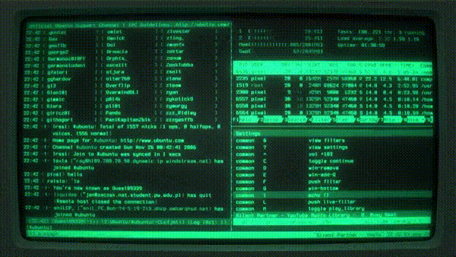

Slide 4
Linux
Technically, GNU/Linux
GNU/Linux is a family of open-source Unix-like operating systems based on the Linux kernel
Open-source means software that’s publicly available, anyone can see, use and even modify the source code.
That’s why it's free and compatible with a large range of hardware.
https://github.com/torvalds/linux

Slide 5
Why Linux?
Linux is extensively used in the tech industry.
Almost every website, and servers are hosted on it due to its way lesser overhead. It’s the fastest.
So, it's important to learn and understand it.
Coming to why we use it for security, it's the safest operating system, with the least risk of malware(there will always be a risk) because the code is open source so patches can be applied quickly.
Easier to manage software packages and tools.

Slide 6
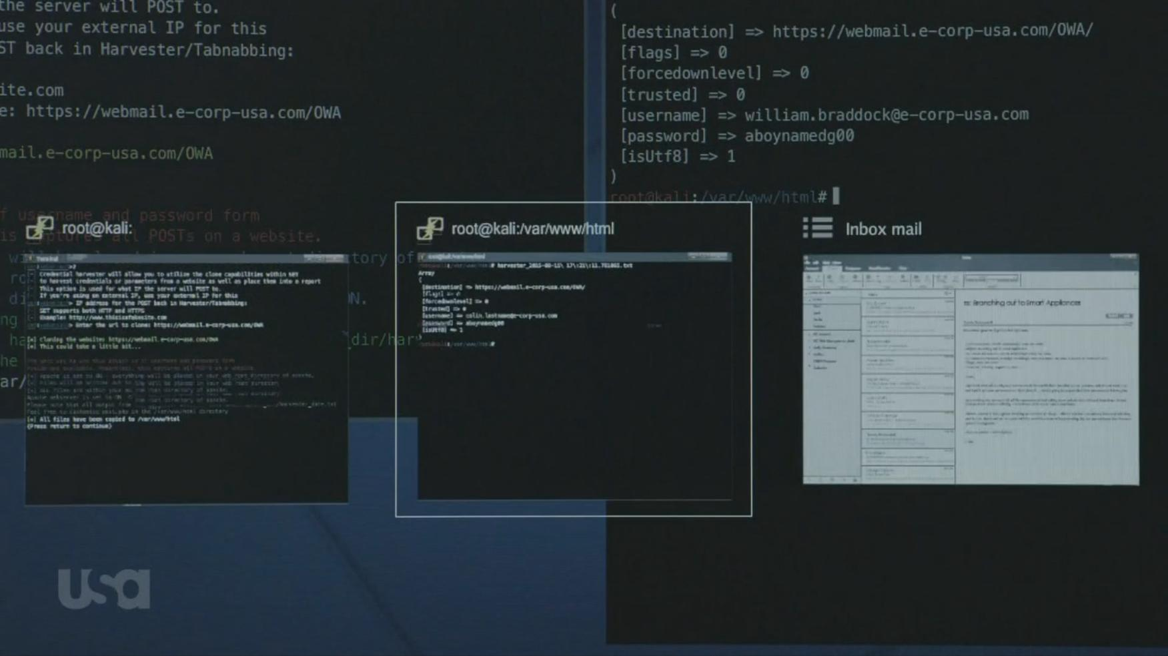

Slide 7
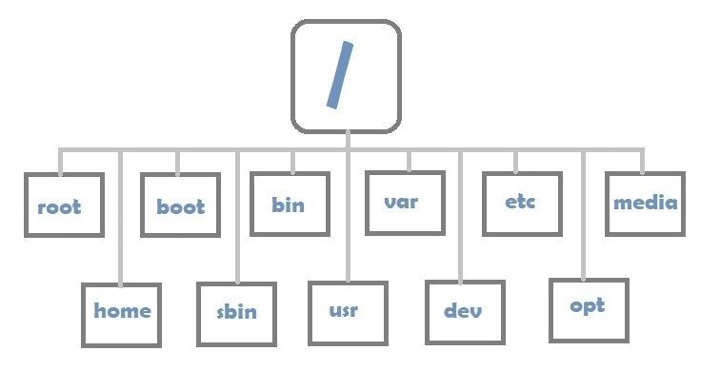
File System in Linux

Slide 8
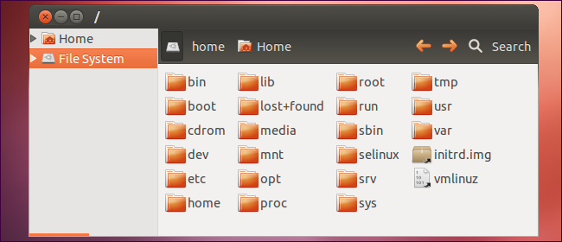
Directories
Directories are nothing but “folders” as we call them in Windows.
They contain the various files.
The entire OS is organized into these directories.

Slide 9
Permissions
Every file has three different permissions:
numeric code
read (r) - can only view 4
write (w) - can view and edit 2
execute (x) - can execute if a program 1

Slide 10
Users and Groups
Linux allows for multiple users to have interactive access to the system. Different users can have different permissions (privileges).
The “root” user is the most-privileged user on the system. Same as “Administrator” in windows
Groups are used to give a number of users (belonging to the same group) the same permissions.
A user can be in multiple groups.

Slide 11
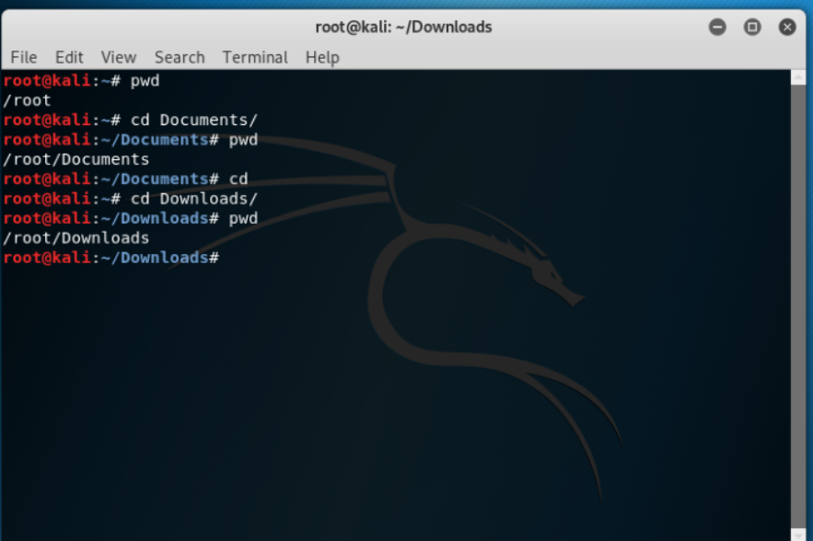
pwd
pwd means Present Working Directory.
This displays the current working directory.

Slide 12
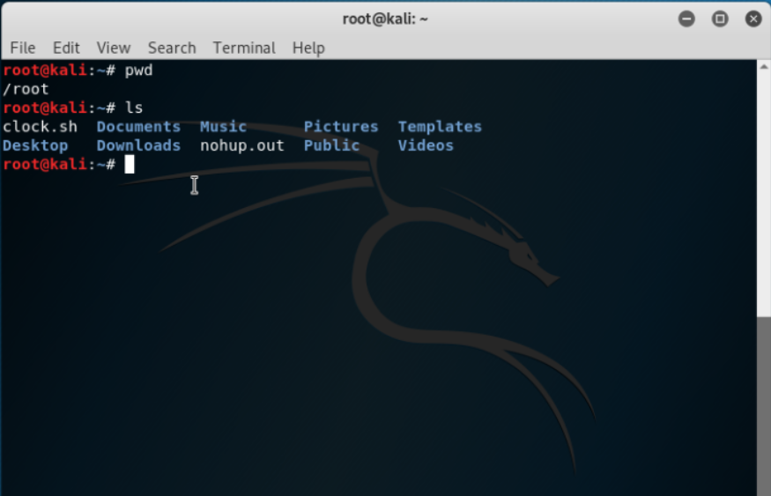
ls
ls is a command in linux which displays the list of files in the current working directory

Slide 13
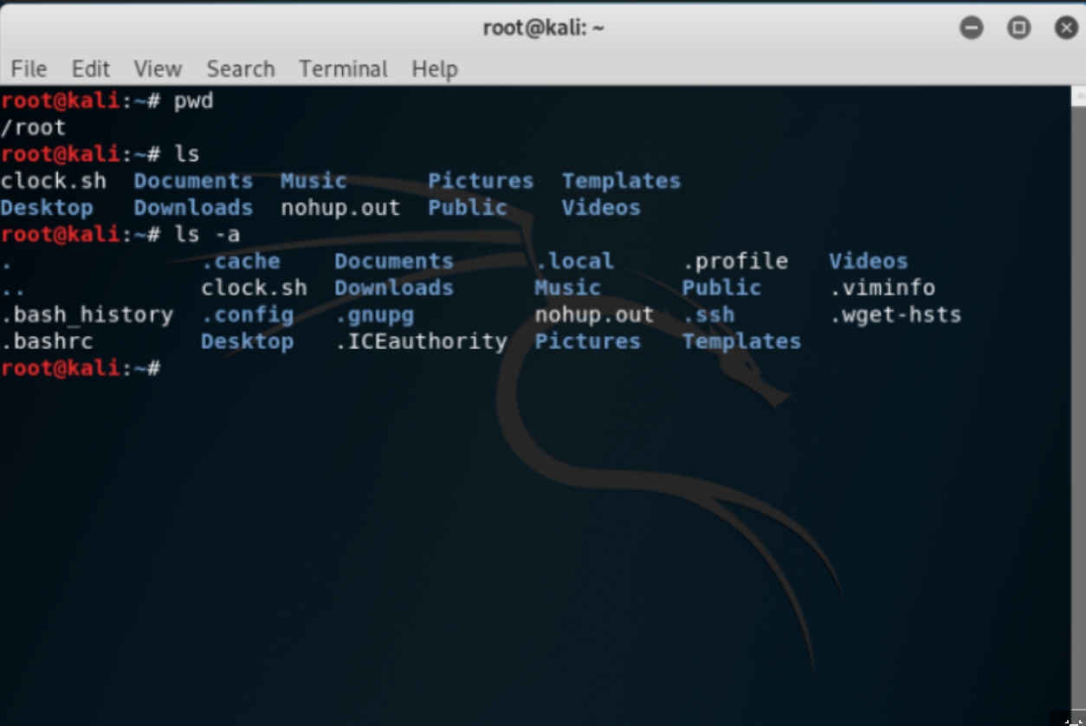
ls - a
ls –a is a command in linux which displays the list of files including the hidden files in the current working directory.

Slide 14
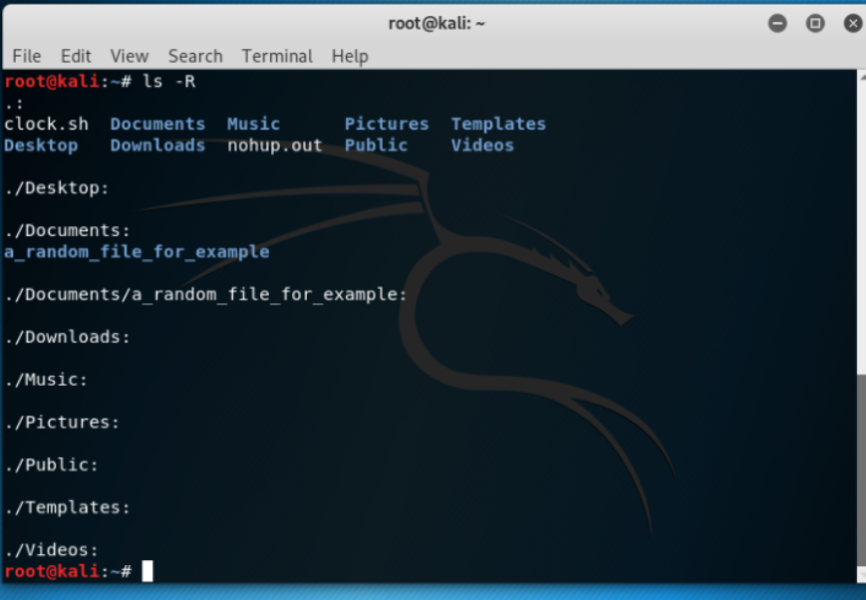
ls -R
ls –R is a command in linux in which it displays the sublists of the lists/ files in the current working directory.

Slide 15
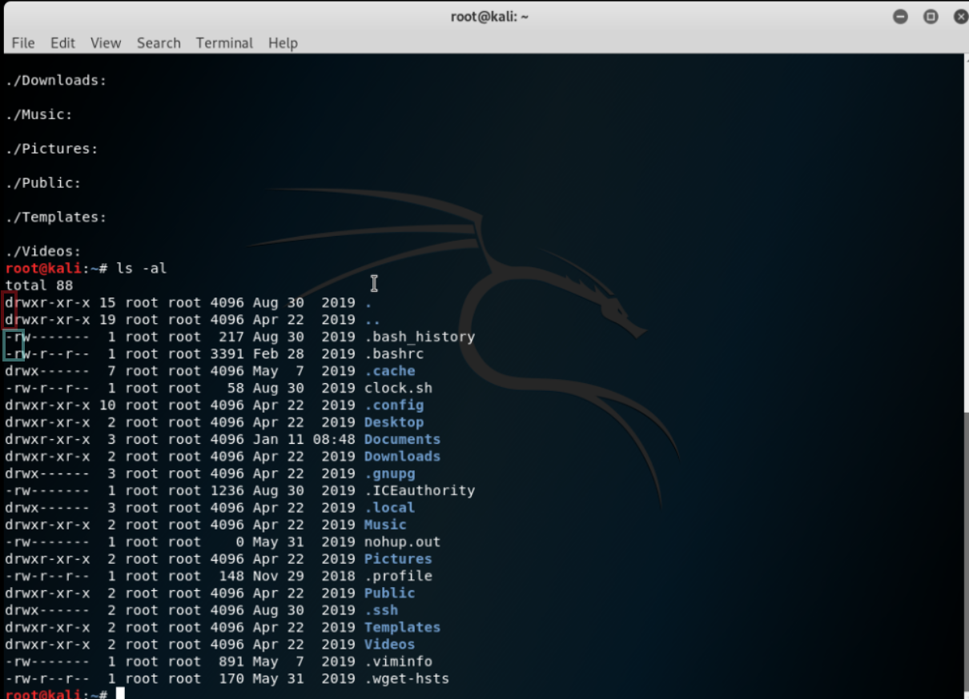
ls -al
ls –al is a command in linux which displays the list of files/directories with details of the current working directory.
Here the details mean the owner who created those files or directories and the date and time when the directory or file is created and the memory in bytes of the file or directory.

Slide 16
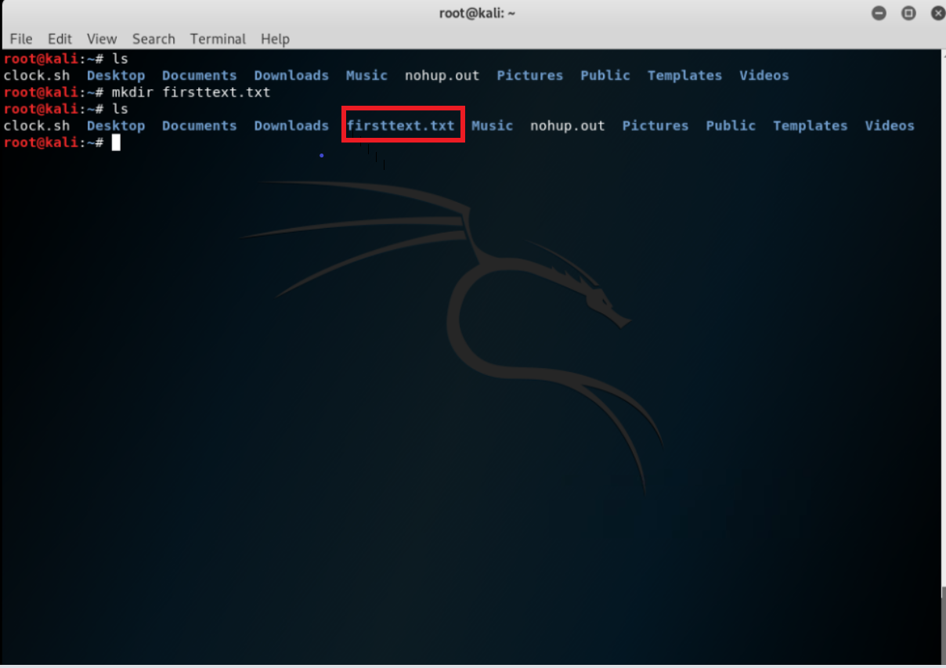
mkdir
This commnad is used to make directories.

Slide 17
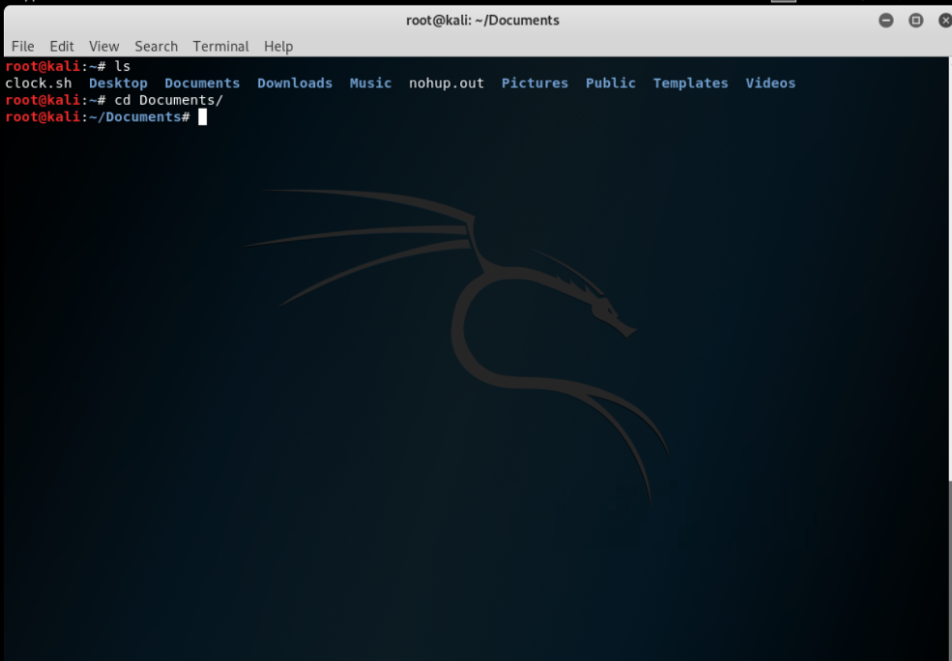
cd “dirname”
cd is the command which is used for switching directories.

Slide 18
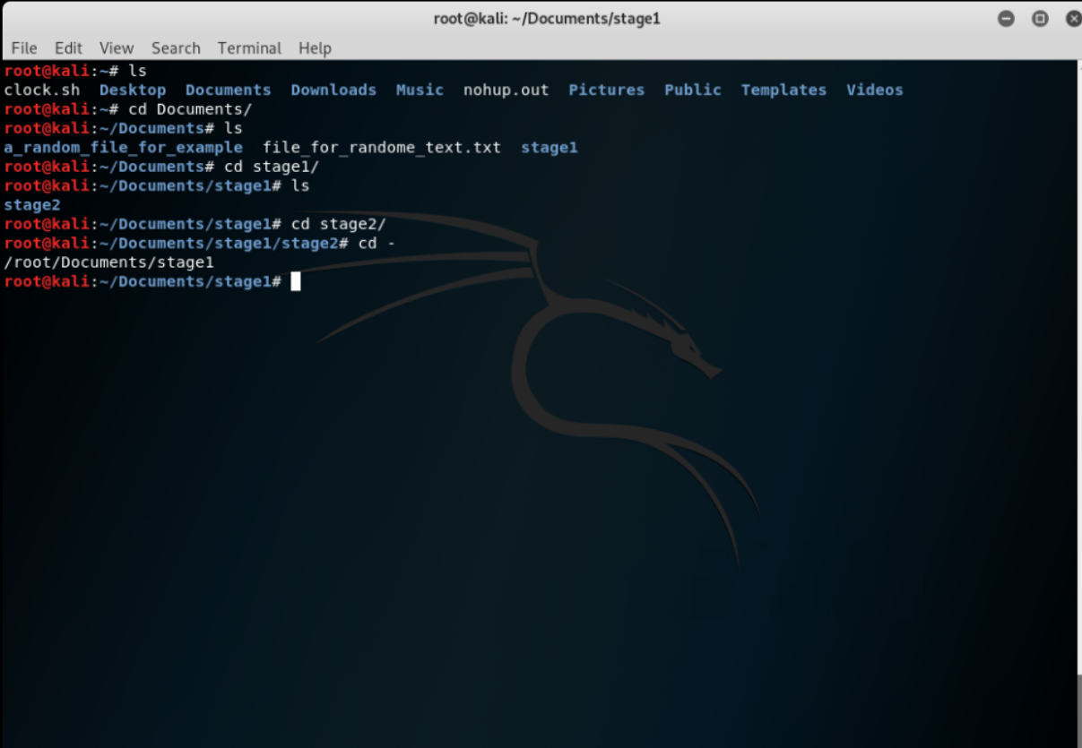
cd -
Here the extra - is used for switching back to the previous directory and displaying the current working directory .

Slide 19
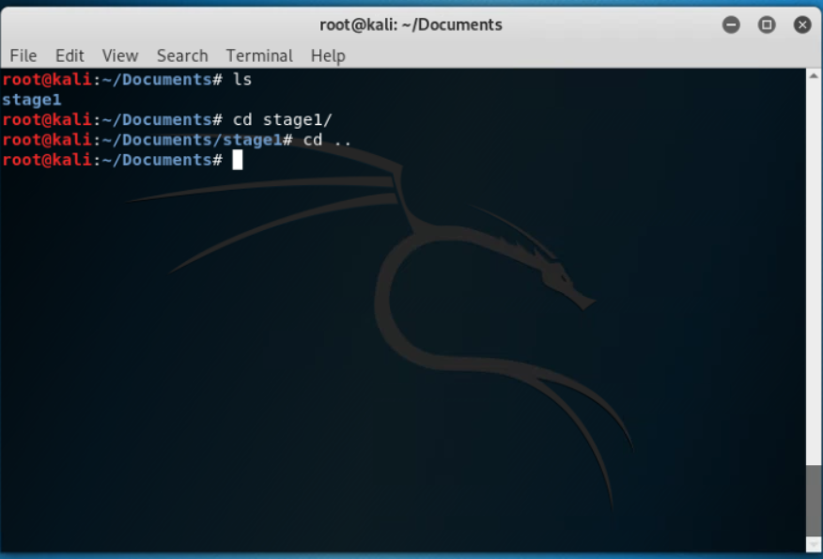
cd ..
Here those two dots serves the same property as of - but by using cd .. there wont be any display of current working directory.

Slide 20
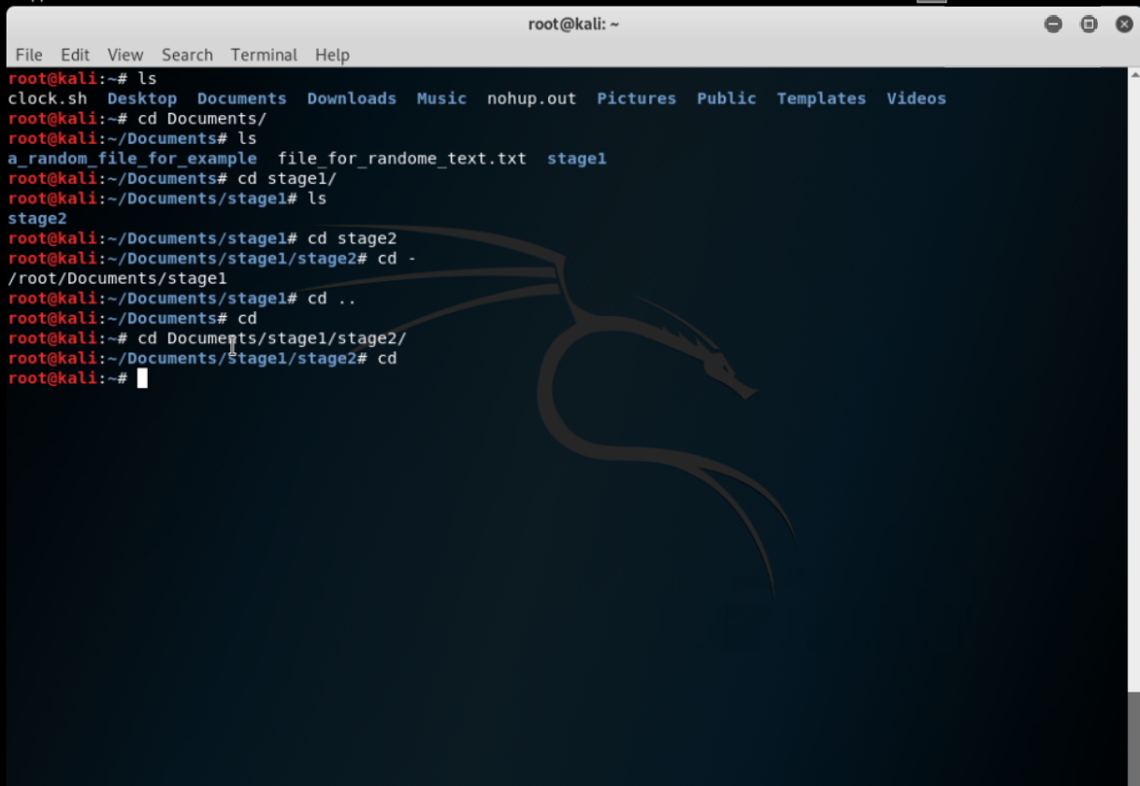
cd
In this case i.e. just cd without any file name after cd switchs the current working directory with home directory.

Slide 21
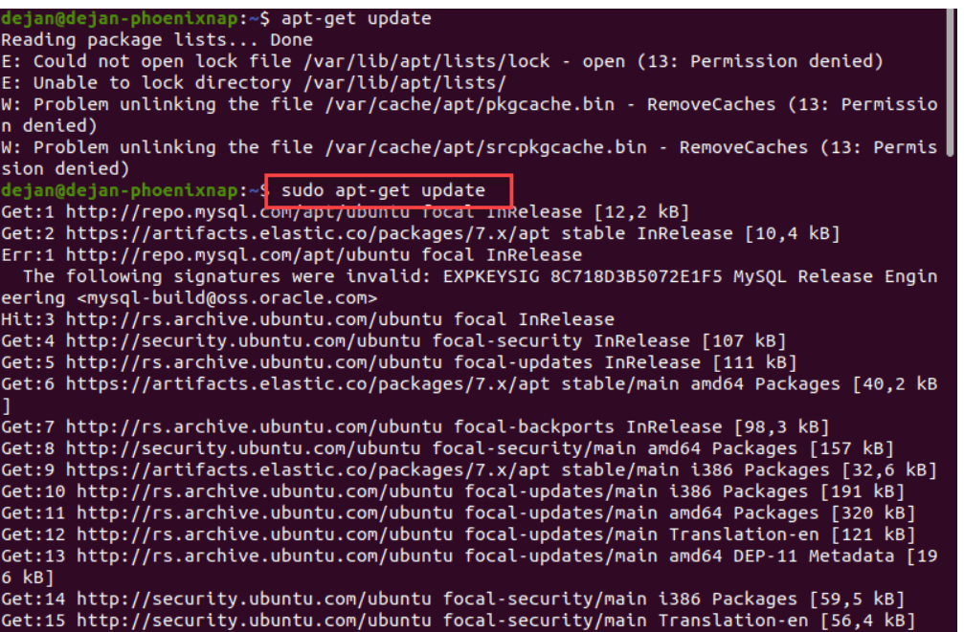
sudo
sudo (Super user do) enables you to perform tasks that require administrative or root permissions.

Slide 22
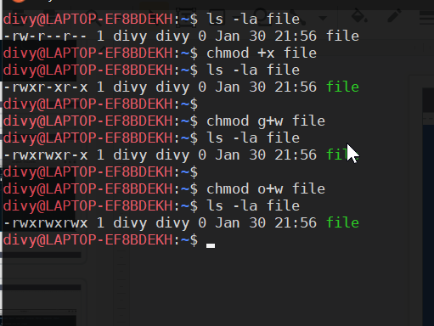
chmod
This is used to change the permissions of a file or a directory.
chmod +x file : every ownership exec permissions
if specific owership: then specify u, g or o with +x or +w

Slide 23
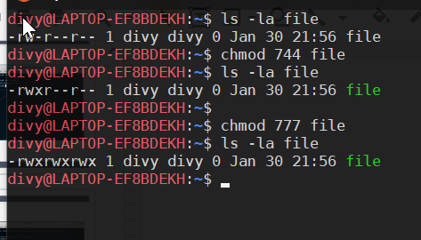
chmod
One can also use numeric codes to assign permissions.
chmod 744 file : 7 (4+2+1) for user and 4 and 4 for group and others.
(Put 0 for no permission)
chmod 777 file : makes the file fully accessible and executable

Slide 24
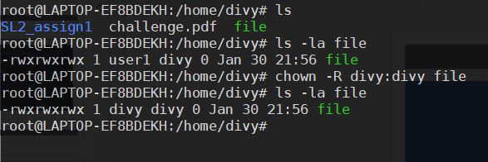
chown
change ownership of a file.
format :
user:group

Slide 25
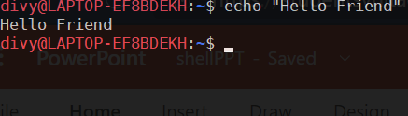
echo
Prints text to the console, enclosed in " "

Slide 26
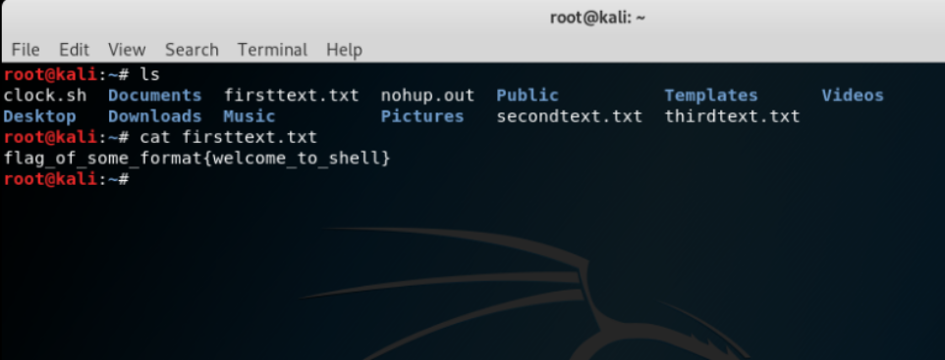
cat “file”
cat followed by file’s name displays the text in that file

Slide 27
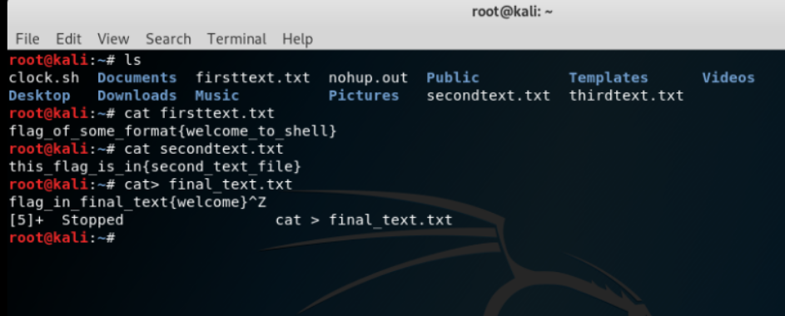
cat >newfile
This command creates a new file, and we can enter whatever text we want.

Slide 28
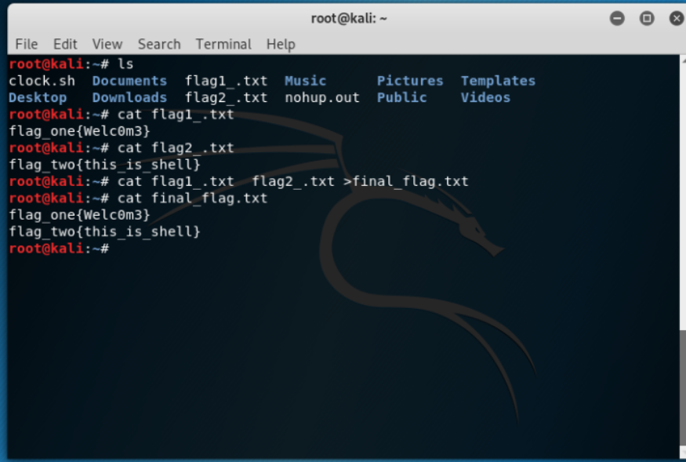
cat f1 f2 > f3
This command saves the text inside file f1 and f2 to file f3.

Slide 29
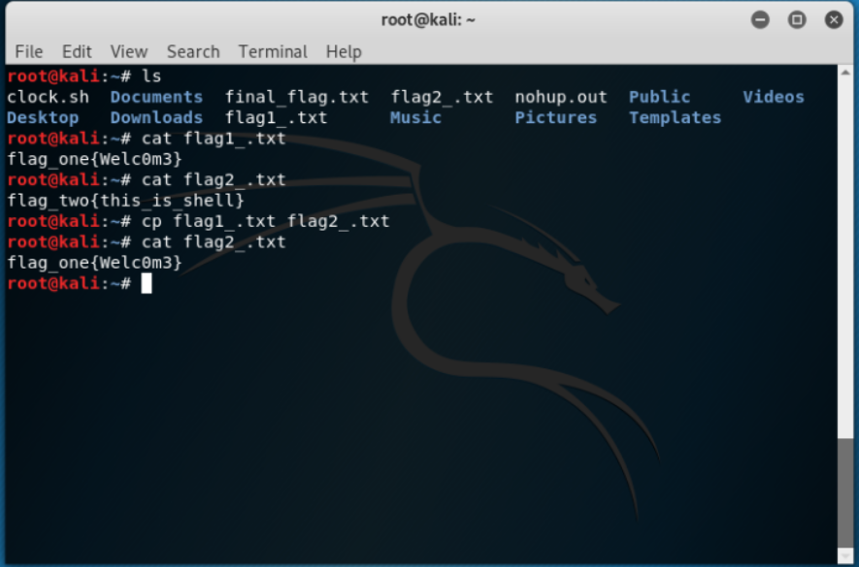
cp
This command is used to copy files from the current directory to a different directory.

Slide 30
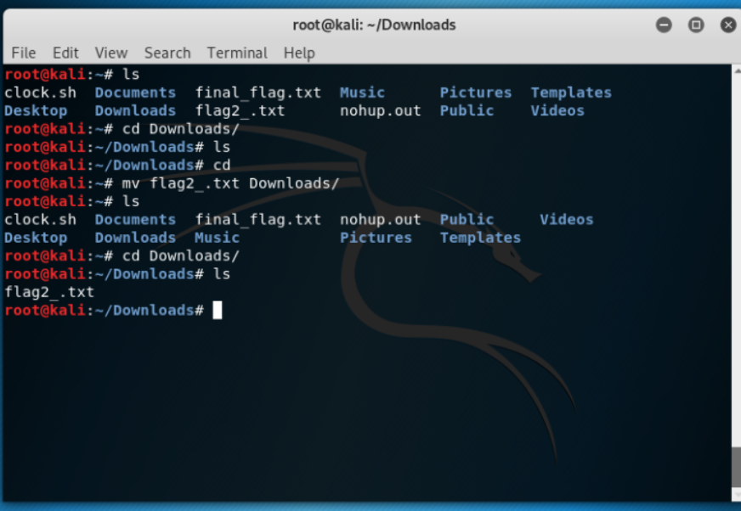
mv
This command is used for moving files or renaming files.

Slide 31
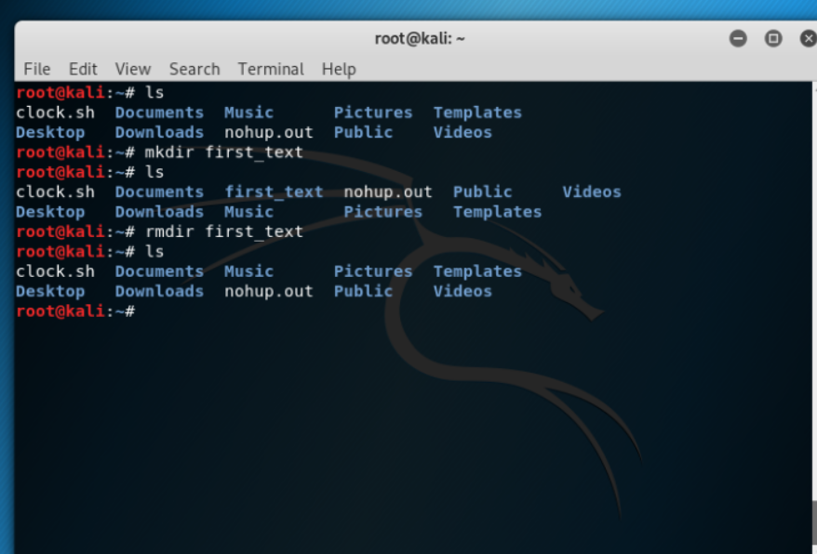
rmdir
This command is to remove directories.

Slide 32
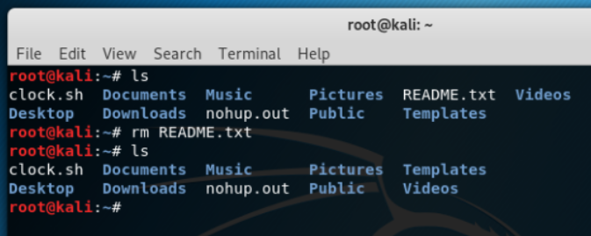
rm
This command is used to delete directories and the contents within them.

Slide 33
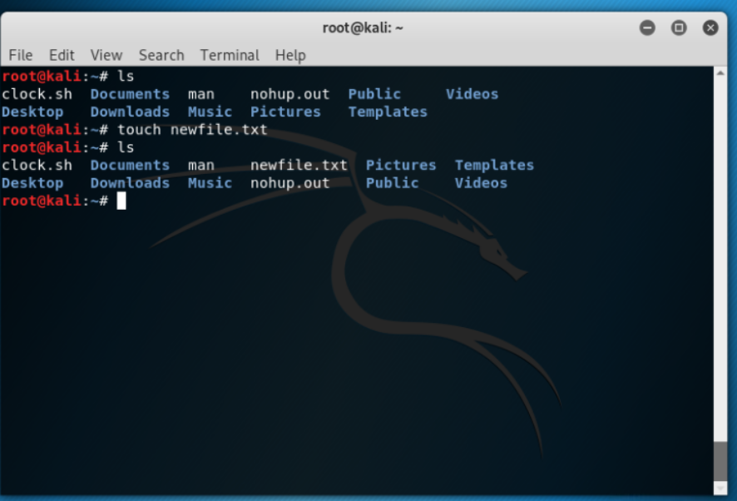
touch
This command allows you to create a blank new file through the linux command line.

Slide 34
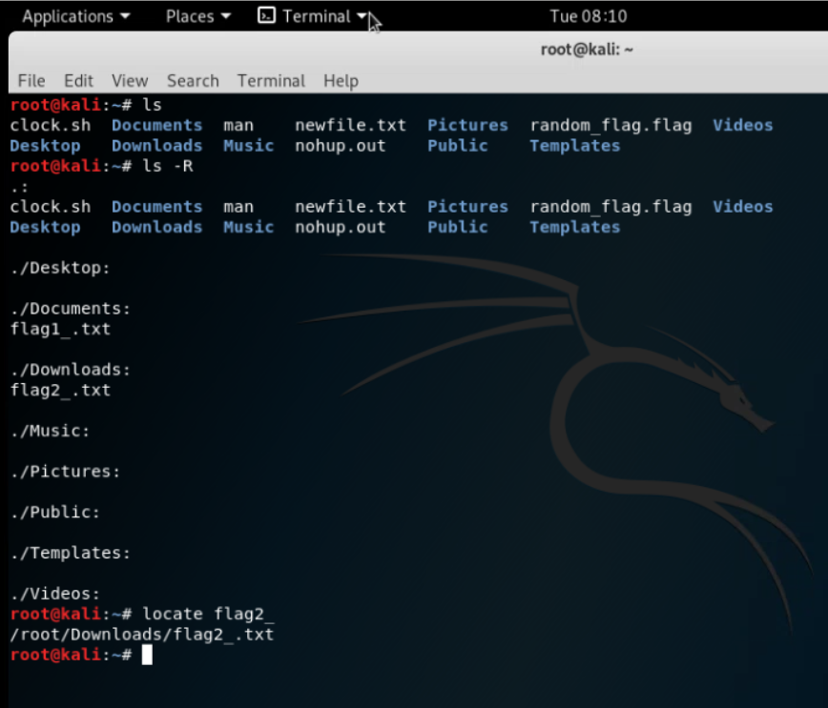
locate
This command is used to locate a file. (case sensitive)

Slide 35
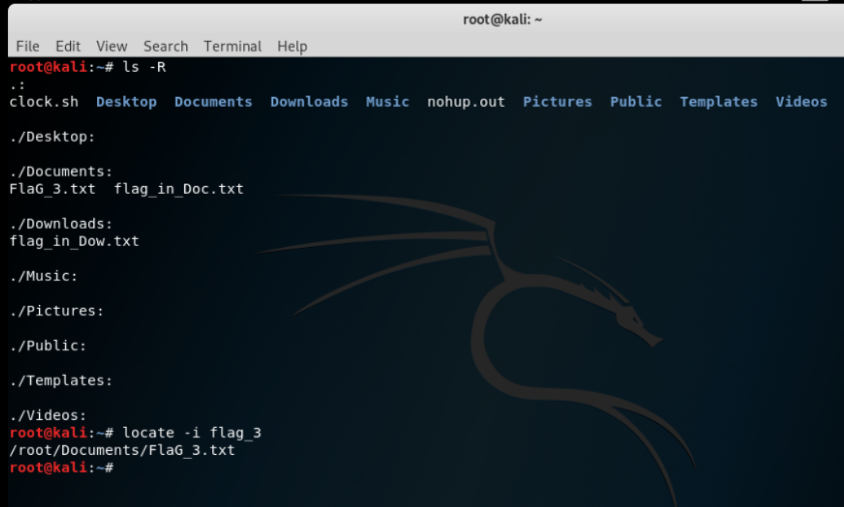
locate -i
This command also serves the same purpose as of the command locate but it is case insensitive.

Slide 36
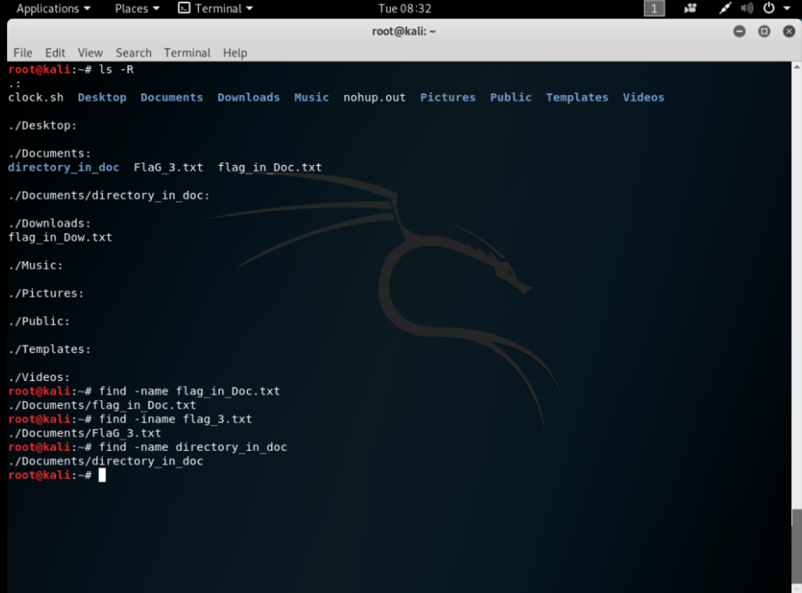
find
This command is similar to the command ‘locate’ this searches files and directories.
Here format is :
find –name “name of file/directory”
find –iname “name of file/directory for case insensitive”

Slide 37
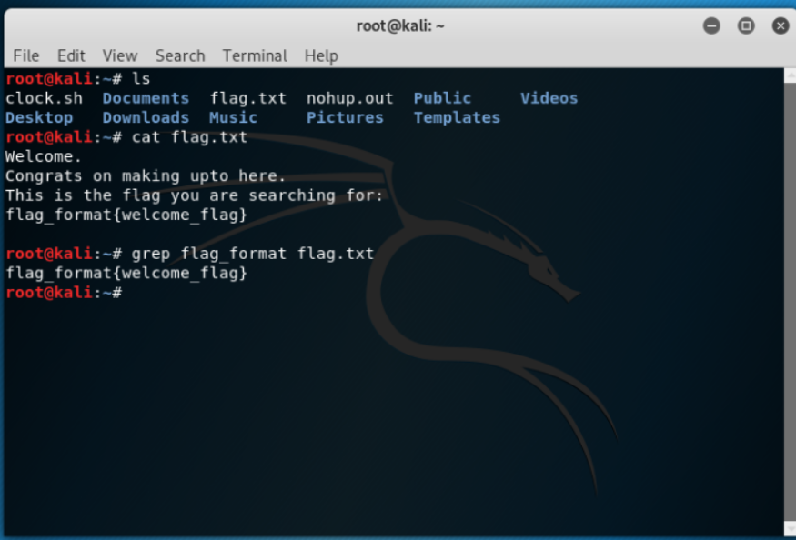
grep
This command helps you to find a specific word in the whole text.

